Slide 1





Spark MLLib Airbnb Listings
Bigger Then Data (BTD)
Abdullah Alhuwaishel
Afnan Alzahrani
Jumana Almussa
Amjad Almusallam
Mahmoud Alhassan

Slide 2

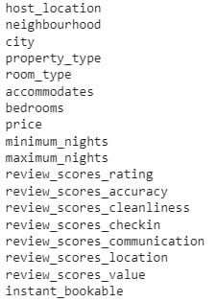
Airbnb Listings dataset
149055 rows and 18 columns

Slide 3
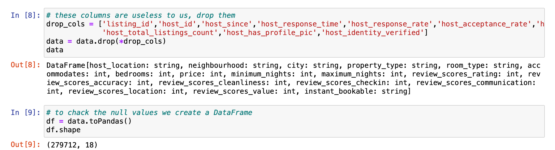
Preprocessing

Slide 4
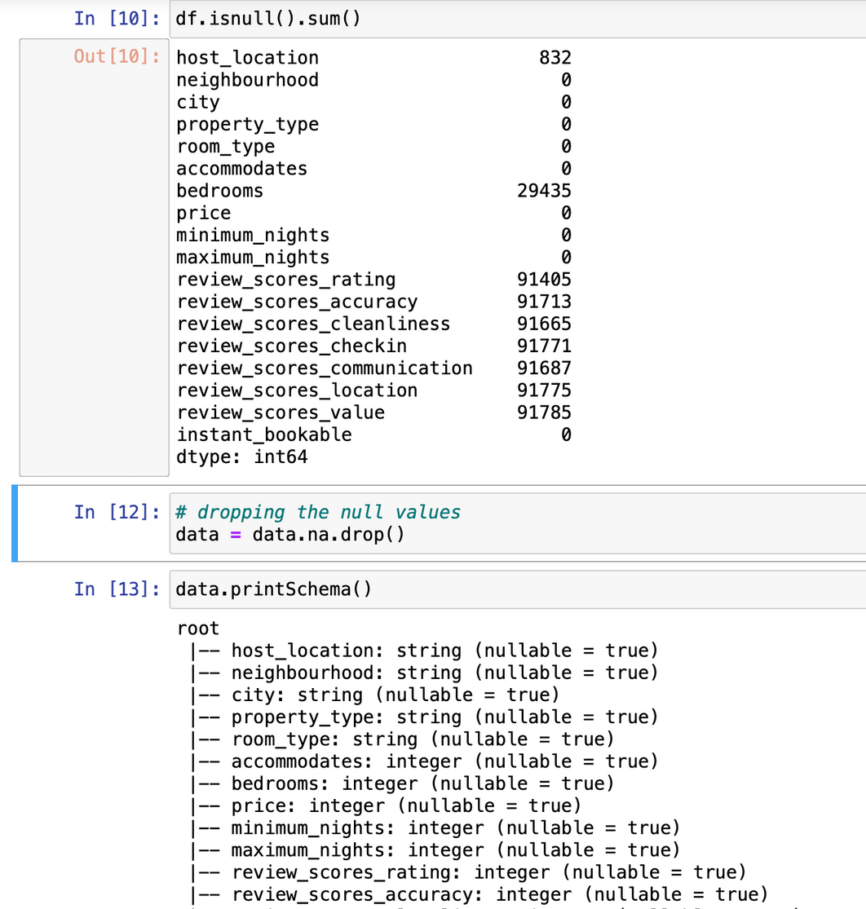
Preprocessing

Slide 5
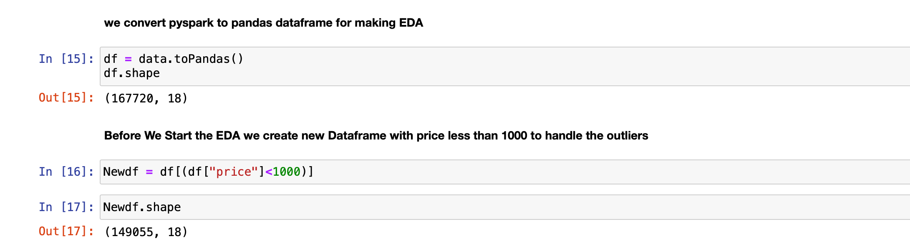
Preprocessing

Slide 6
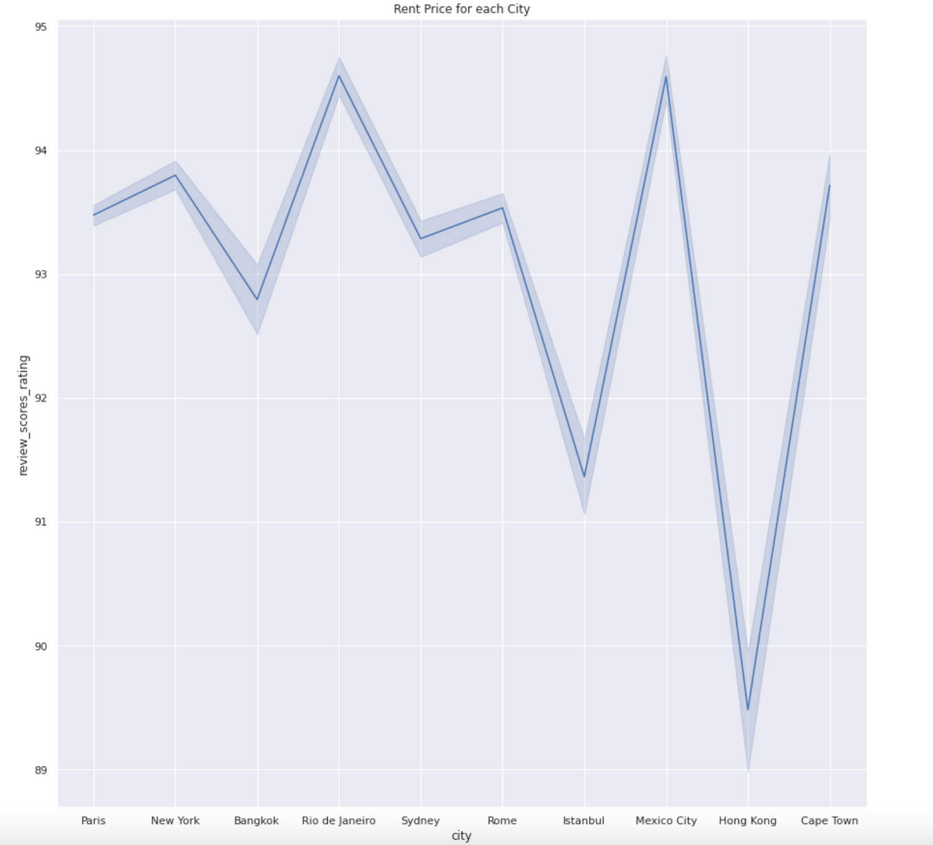


EDA

Slide 7
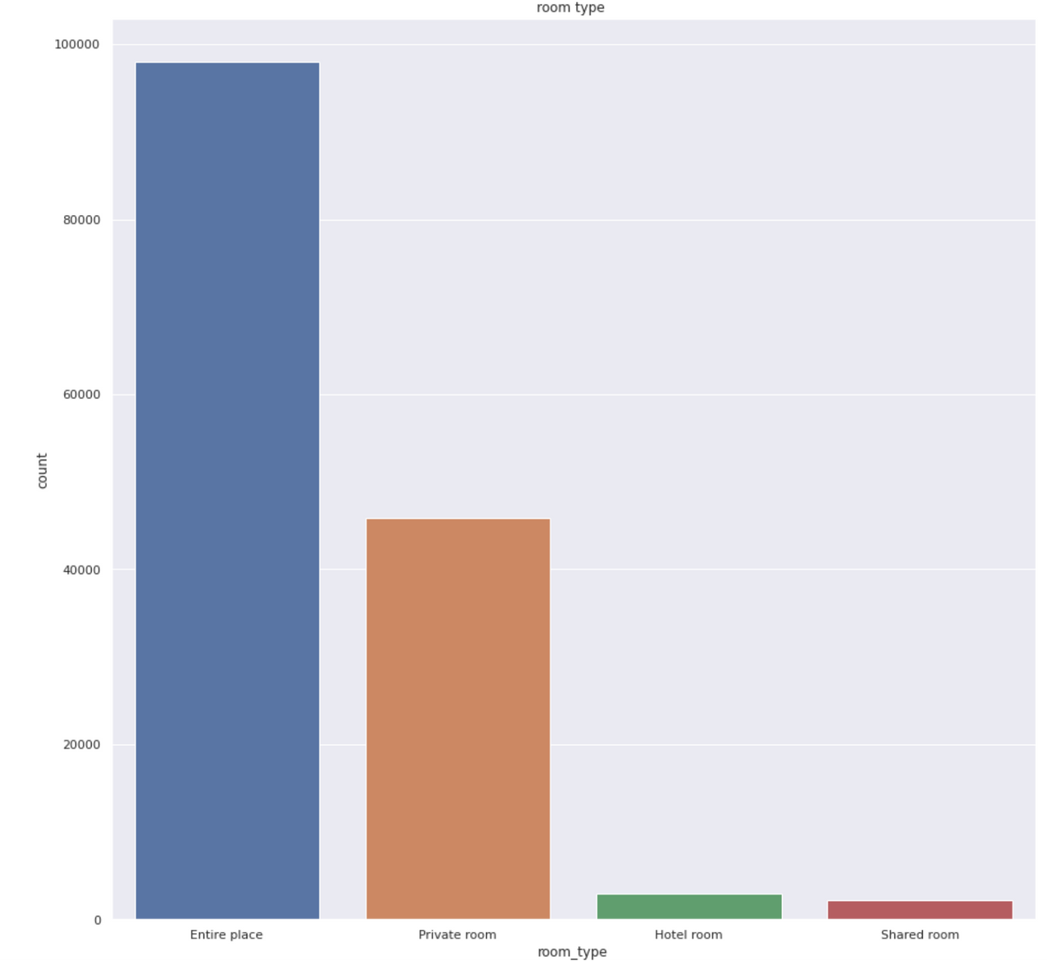
EDA

Slide 8
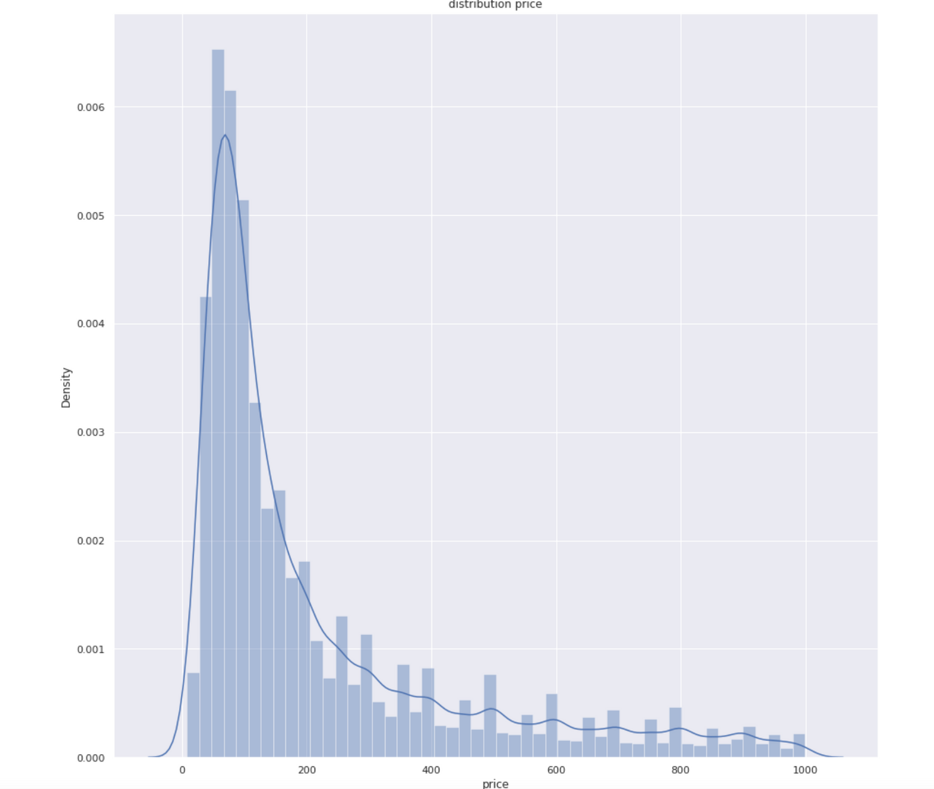
EDA

Slide 9
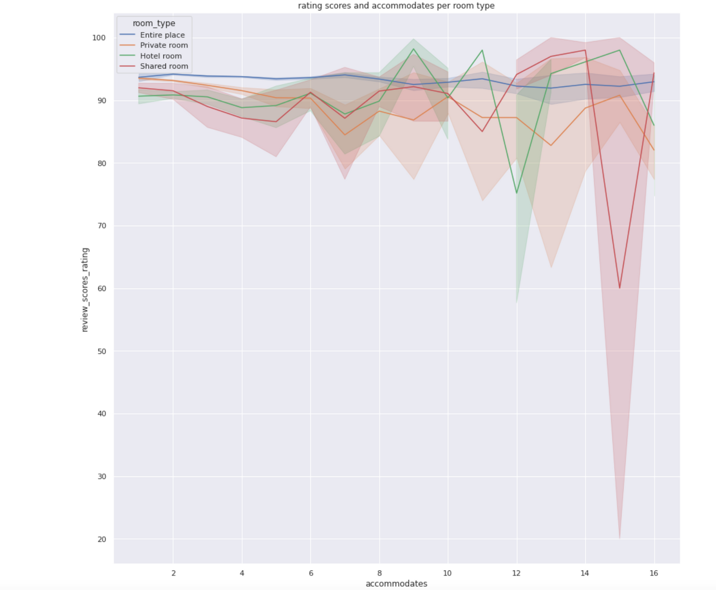
EDA

Slide 10
Data Processing
converting the features to vectors

Slide 11
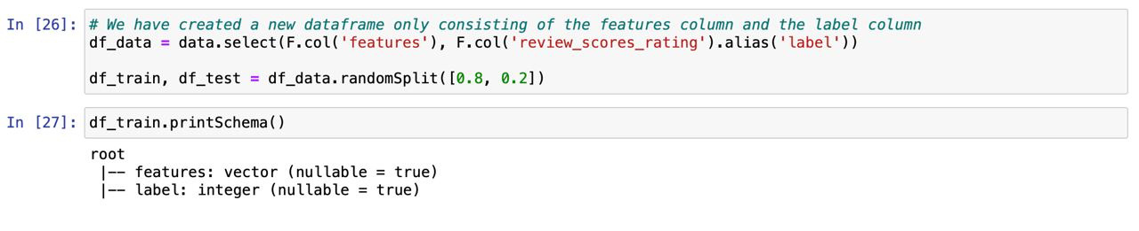
Splitting data

Slide 12
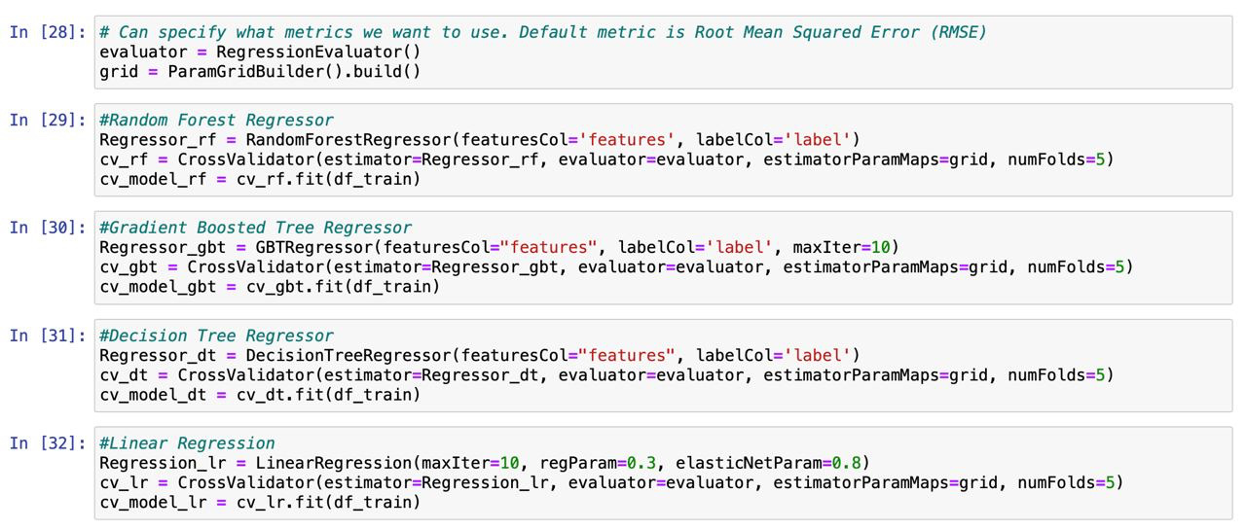
Models

Slide 13
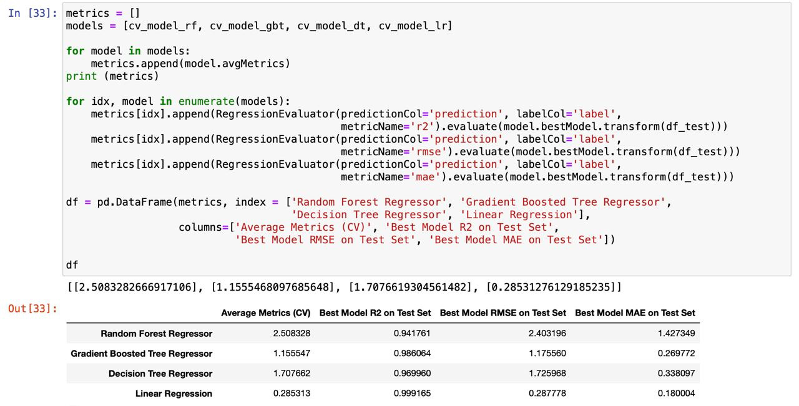

Model Evaluation
Linear Regression is the best model because it has the lowest RMSE and MAE and the highest R2 score.

Slide 14


Thank you!

